Slide 1

Sign Language
Recognition
Navneet Desai
Adish Pathare
Anubhuti Puppalwar

Slide 2
Introduction
Approximately 400K - 500K people using ASL as their primary language.
Goal: To explore machine learning approaches and develop an approach using existing libraries and modules to maximize accuracy with limited data set.
Why is it important?
Communication with people who haven’t learned ASL
Difficulty communicating with technologies like Siri & Alexa
Lack of motivation among students to learn sign language
compared to other languages.

Slide 3
Background
Focus of research on SLR has been on recognition through static dataset
Implementation using static images suffices for the scope of detecting ASL alphabet
Recognition of complete sentences / phrases in ASL requires sequence detection and processing using complicated models like RNN
Most implementations require thousands of images or more
Could we achieve similar accuracy with a smaller data set?

Slide 4
Approach
Step 1: Video Capture
Use OpenCV library for capturing videos using primary camera
Display captured frames(images) on the window
Frames will be rendered as a video to the user
Why OpenCV?
High Speed: Captures 30 frames/sec
Alternatives like Matlab need more system resources
Ease of use

Slide 5
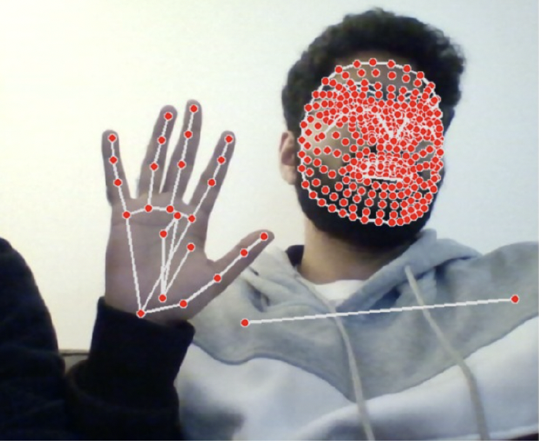
Approach
Step 2: Landmark detection using MediaPipe
Machine learning framework that integrates separate models for pose, face and hand components, each of which are optimized for their particular domain.
Convert BGR frame to RGB for processing using mediapipe

Slide 6
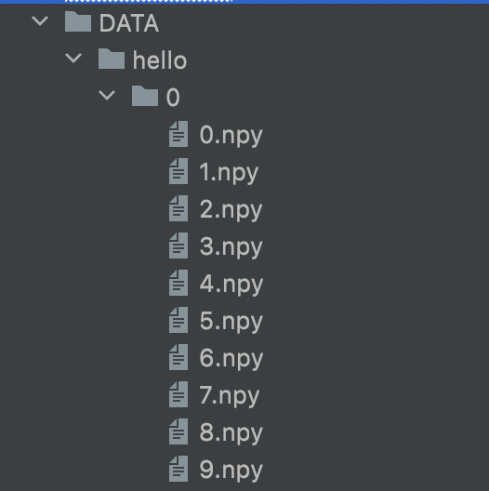
Approach
Step 3: Data Preprocessing
Extract pose, face, and hand landmarks
Flatten and concatenate the result into a numpy array
Each sequence (video) captures 30 frames
Each frame contains 1662 landmark values
We store each frame as a ndarray in a ‘.npy’ file
Notes:
Basically, 30 videos per action, each video sequence
contains 30 frames, and each frame contains 1662
landmark values

Slide 7
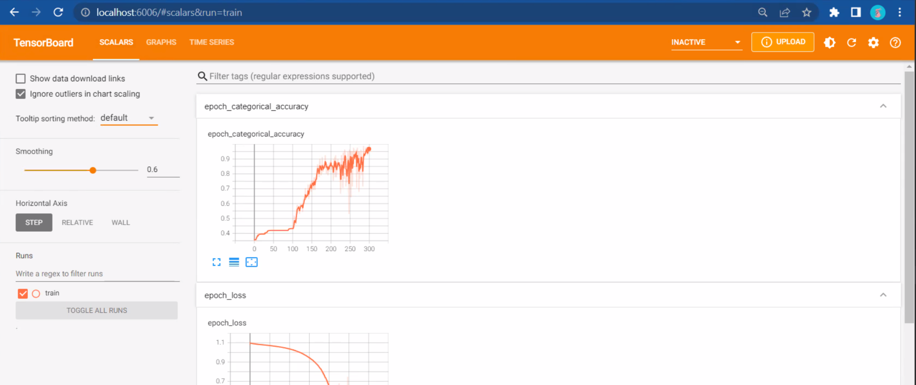
Approach
Step 4: Split data into train and test data using sklearn
Splits the data-set into training and testing input
Step 5: Configure TensorBoard for measurement & visualization

Slide 8
Approach
Step 6: Build & Train the Sequential LSTM Model for 300 Epochs
Epochs used: 10, 100, 300, 500
Optimality achieved at 300
Epochs under 300 have lower accuracy
Epochs over 300 lead to overfitting - the model gets trained much specifically for the training data and loses generalization
Step 7: Prediction
Capture frames from camera & feed them to the model for prediction
Threshold: 75%

Slide 9
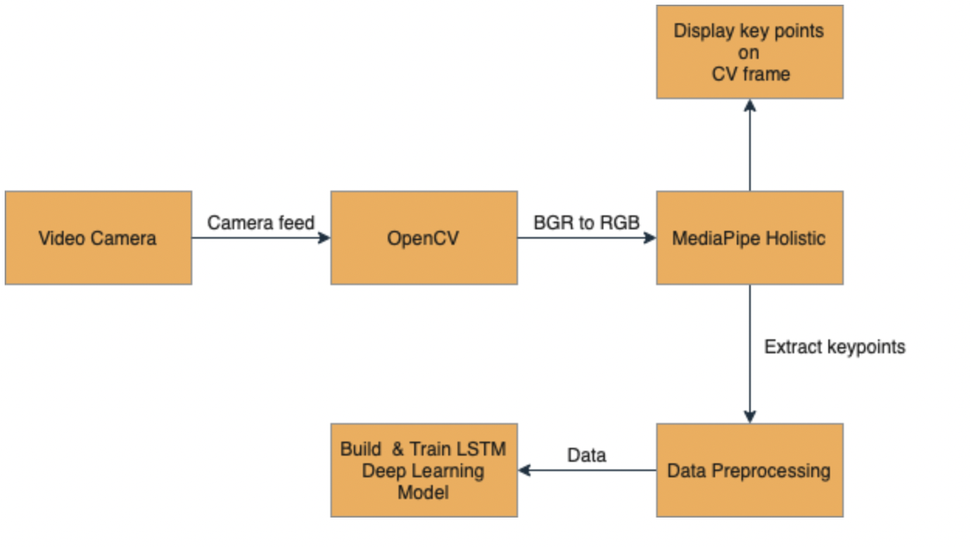
Architecture

Slide 10
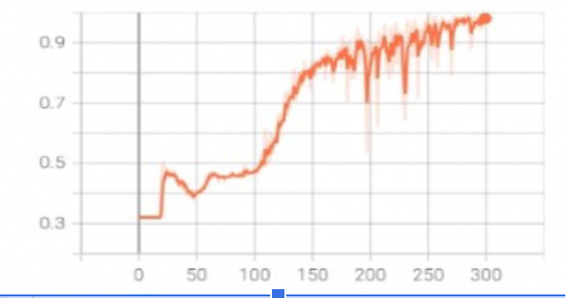
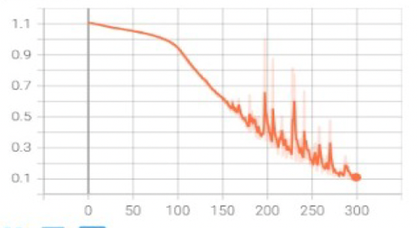
Results
Epochs vs Accuracy
Epochs vs Loss

Slide 11
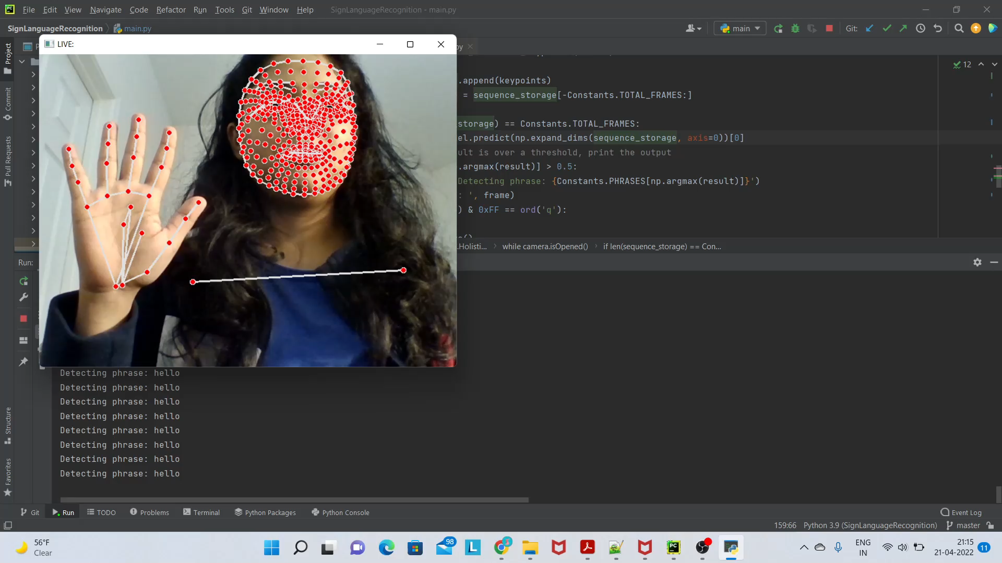
Demo

Slide 12
Outcome
Usage of denser NN minimized training time
Faster detection in real time
Maximized accuracy with limited data-set

Slide 13
Conclusion And Future Scope
Machine learning algorithms helps to train a model with existing datasets which includes the commonly used sign language notations.
Implementation can be extended for an extensive set of words and sentences from the ASL.
Can be extended to translation from sign language to natural language.

Slide 14
THANK YOU

